Slide 1
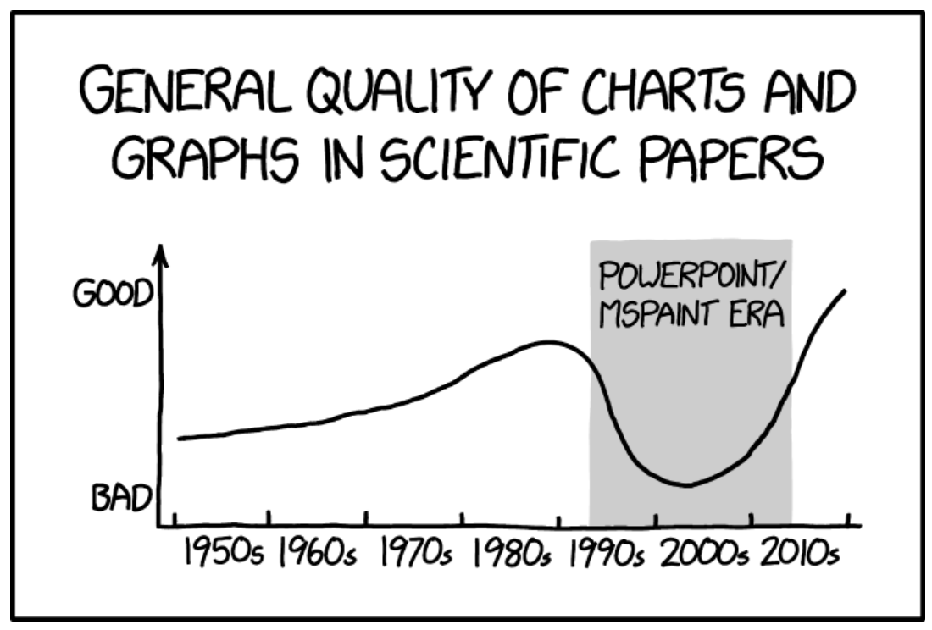
Experimental Design Biology 683 Problematic plots Heath Blackmon

Slide 2
Plan for today
General rules for making plots
Programs for plotting
Resources for plotting

Slide 3
Rules for plots
Show the data

Slide 4
Show the data

Slide 5
Rules for plots
Show the data
Avoid distorting data

Slide 6
Avoid distorting data

Slide 7
Rules for plots
Show the data
Avoid distorting data
Avoid chart junk

Slide 8
Avoid chart junk

Slide 9
Rules for plots
Show the data
Avoid distorting data
Avoid chart junk
Maximize data:ink ratio maximize information

Slide 10
Maximize data:ink ratio maximize information

Slide 11
Rules for plots
Show the data
Avoid distorting data
Avoid chart junk
Maximize data:ink ratio maximize information
Serve a purpose

Slide 12
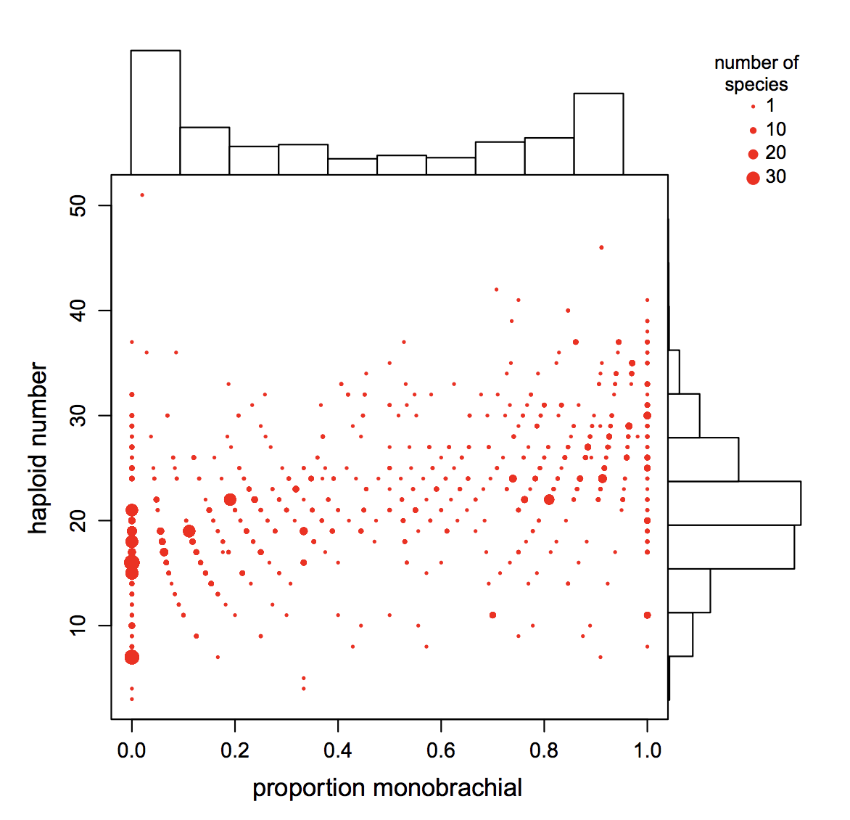
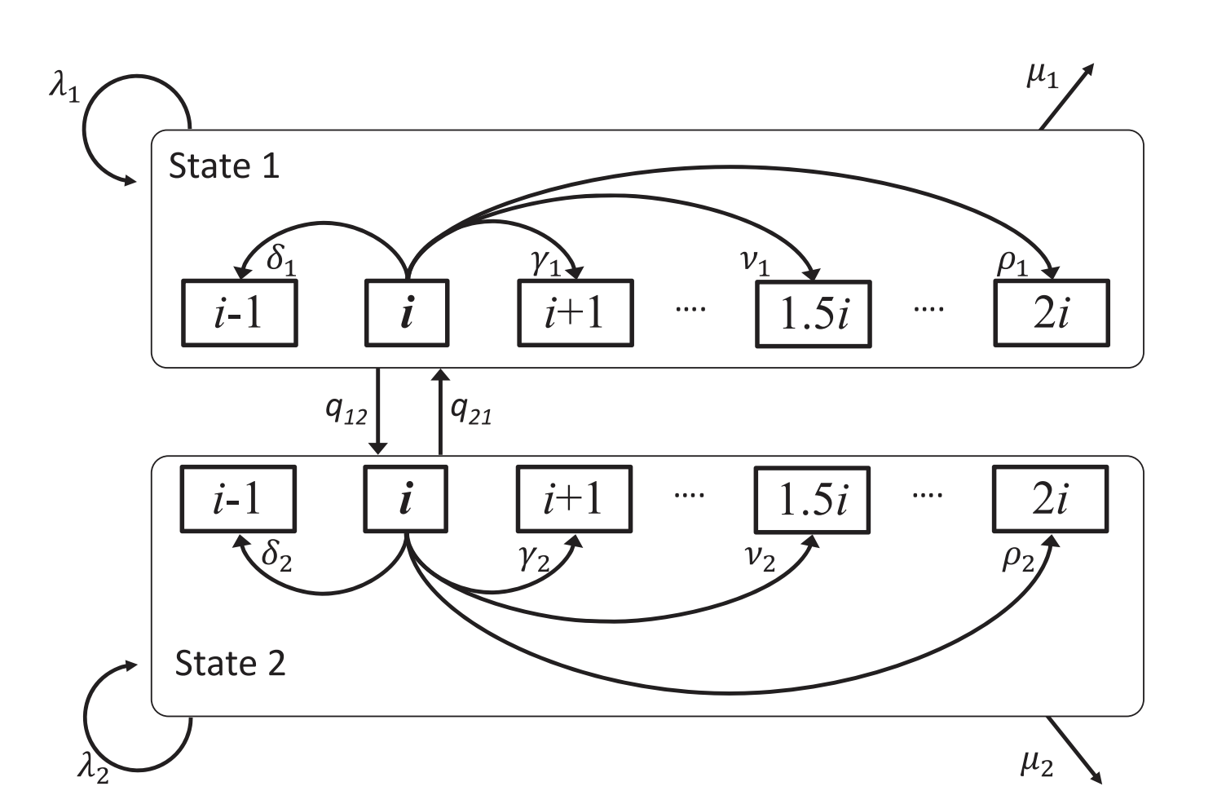
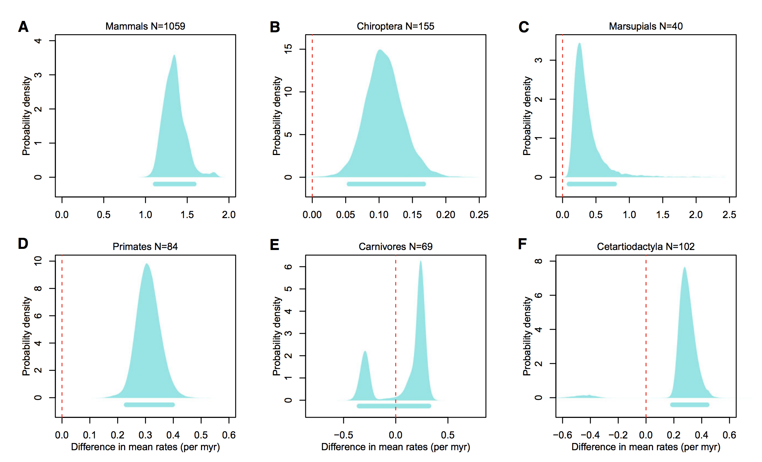
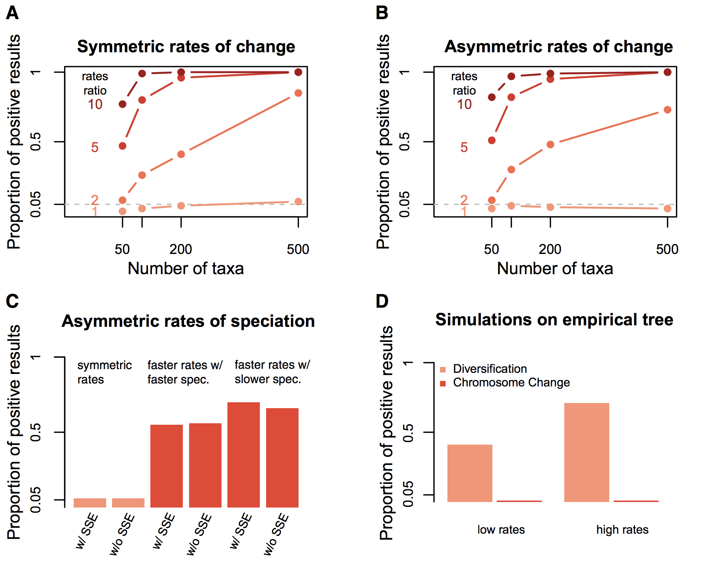
Serve a purpose
New tool and it works
The Problem/Question
The Answer

Slide 13
Rules for plots
Show the data
Avoid distorting data
Avoid chart junk
Maximize data:ink ratio maximize information
Serve a purpose
Make it accessible to all (5% color blind + BW prints).

Slide 14
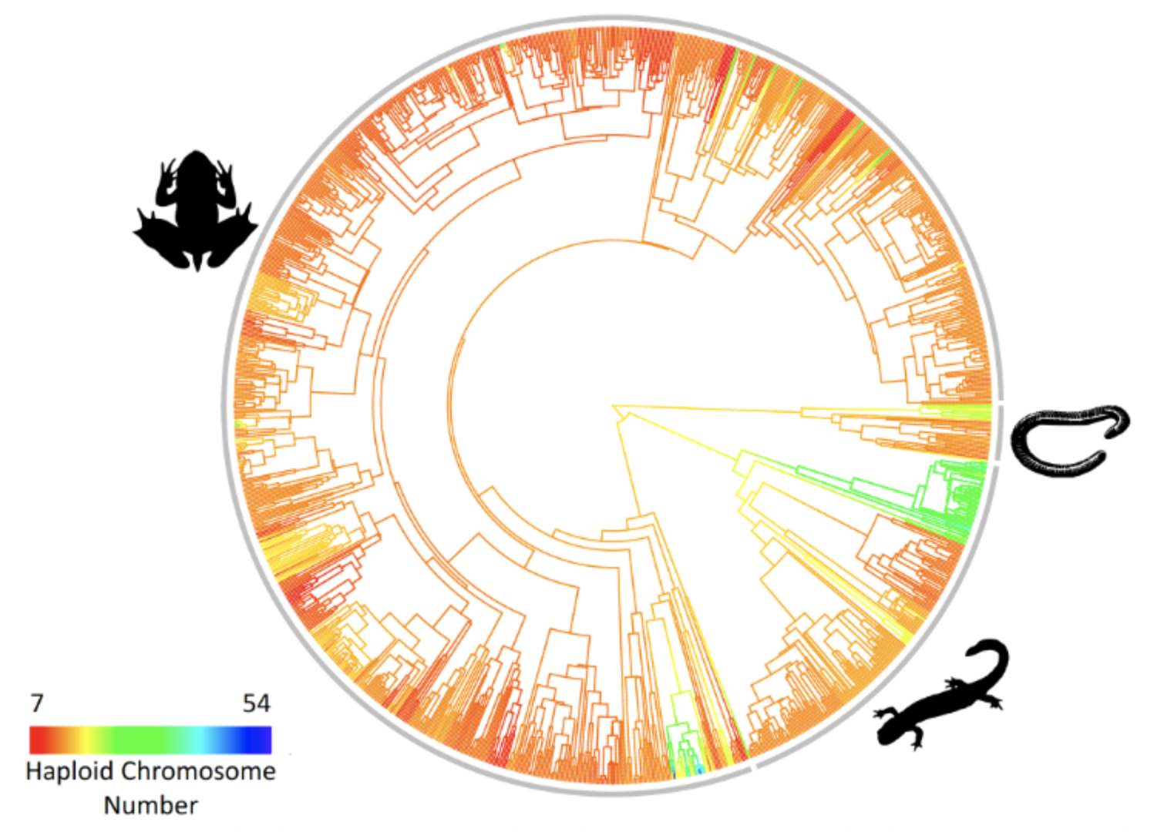
Make it accessible to all

Slide 15
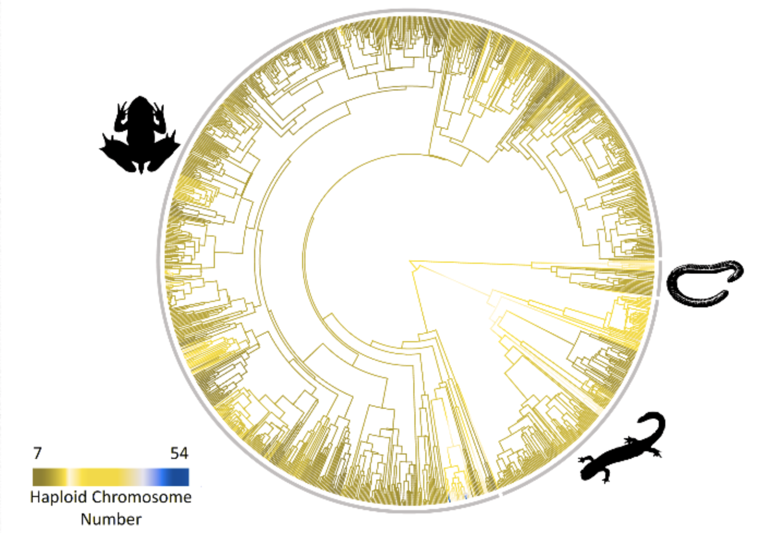
Make it accessible to all
Use the viridis color palette
Color blind simulator

Slide 16
Use the right tool
Plotting continuous or discrete data
Matplotlib: is a python plotting library,
R: endless packages for plotting though base and ggplot2 are the most popular.
Inkscape: free vector graphics editor. Can read PDF and let you tweak things you couldn’t quite fix in your script generated version.
Circos: created plots that compare genomes but can show connections between any large datasets.
Excel: it is possible but you have very limited options and control
Adobe Illustrator: Similar to inkscape particularly useful for building complex multipart figures
Image Manipulation
GIMP: Think of it as free photoshop. Steep learning curve but can do just about whatever you want
ImageJ: Similar to GIMP but with many packages for analyses of specific image types.
Photoshop: Image manipulation steep learning curve very powerful and definitely worth learning if your research includes figures of FISH results.
General Editing
Adobe acrobat: often the easiest way to tweak something small you couldn’t get exactly right in your script.
Powerpoint: not elegant but often the easiest way to combine different elements into a single plot.
Bold = Free

Slide 17
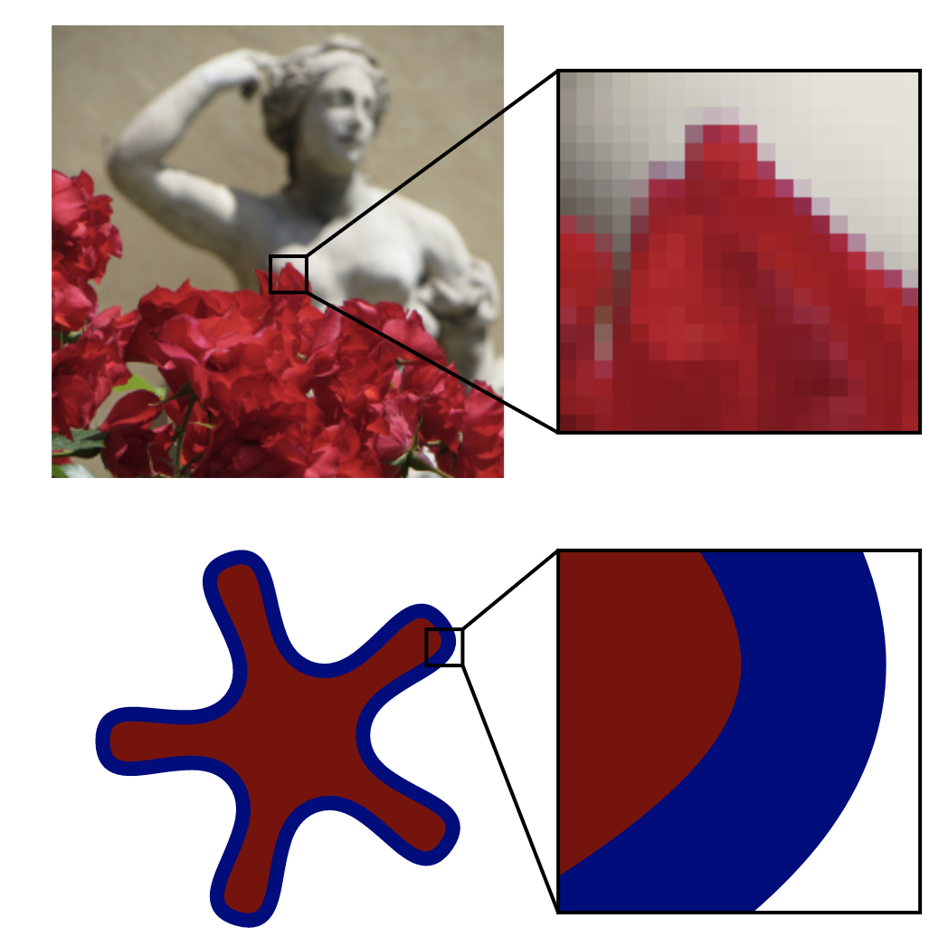
Types of images
Vector images
Raster images
jpg, tiff, png, bmp, raw
eps, pdf, svg

Slide 18
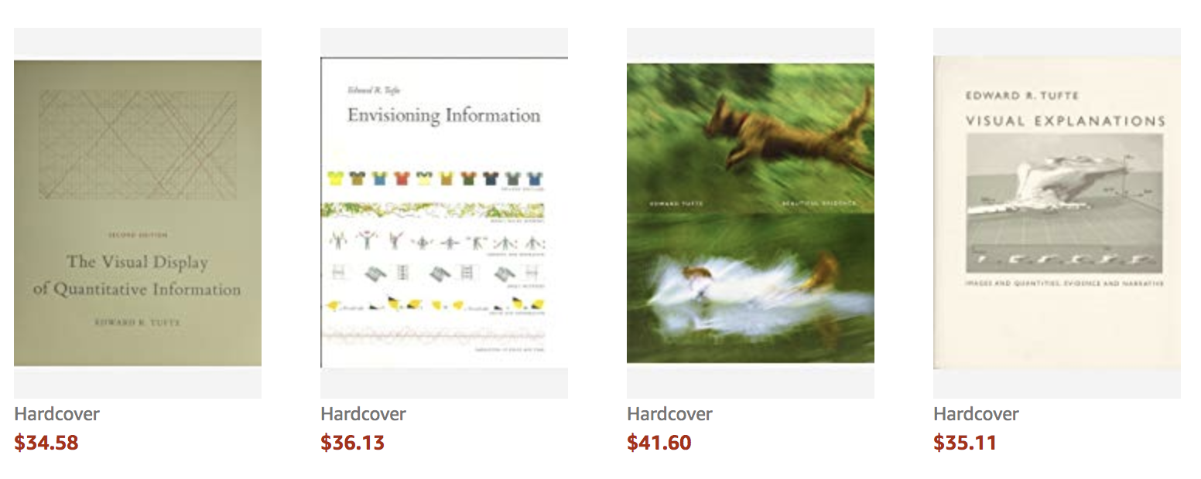
Resources
R graph gallery
Python graph gallery
Color Brewer
Plotly
Data Visualization Catalog
Philosophy of Data Visualization

Slide 19
Final
Everything we have already covered
Using a linear models and interpreting the result thereof including adding in a random effect.
being able to manipulate data and get it ready for analysis
making plots that look good and are ready to be submitted for publication

Slide 20
Homework
Find a plot that you think could be improved and take a screen shot and upload to this folder. We will discuss them in class on Thursday. Name the file with your name.
This week:
Thursday (April 18): bad graphs and Dimensional reduction.
Next week:
Tuesday (April 23): species as data points
Thursday (April 25): R lab - with review sheet
Following week:
Tuesday (April 30) : last day of normal class – review and feedback
Options for final
Give you take home on Tuesday April 30
Come back on May 7 from 1-3pm

